Slide 1


BOD Architecture Refactoring Project Update
Standards for Technology in Automotive Retail
Standards for Technology in Automotive Retail

Slide 2
Meeting Agenda
Vehicle Inventory and Parts Master BOD Refactoring
Metadata Concept
Next Steps and Deliverables for the 2020 STAR Meeting
Standards for Technology in Automotive Retail

Slide 3
BOD Architecture Refactoring Vehicle Inventory and Parts Master
Standards for Technology in Automotive Retail
Standards for Technology in Automotive Retail

Slide 4
Refactoring Approach
Refactoring approach using best practices defined during technical session in Nashville, and new observations during the refactoring sessions of Vehicle Inventory and Parts Master BODs.
Reorganize large components into smaller components/groups
Group elements with similar characteristics
From new simple components, build Aggregate Business Information Entities (ABIE) based on BOD Context
Rename elements that use a schema field "type" in the name. For example PartClassCode to PartClass
Identify redundant elements in a BOD
Clean up deprecated elements
Free format codes instead of enumeration when appropriate
Standards for Technology in Automotive Retail

Slide 5
Refactoring Actions
We distributed two Excel documents that describe the refactoring actions for the Vehicle Inventory and Parts Master BODs
The next slides provide information on the refactoring items that need to be explained in more detail
Standards for Technology in Automotive Retail
Notes:
Any questions about the two Excel documents?

Slide 6
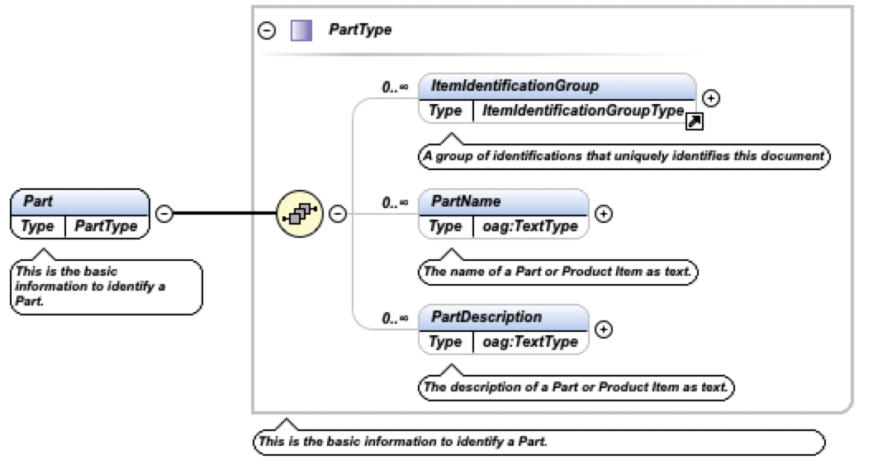
Parts Refactoring Actions
New PartType component defined as element “Part”
This new ”Part” element will replace the ItemIdentificationGroup under the PartsProductItem component.
Consequently, all BODs that contain the PartsProductItem will inherit the new Part element.
This new element is a good candidate for defining a JSON equivalent.
Standards for Technology in Automotive Retail

Slide 7
Parts Refactoring Actions
Define a generic component "ReferencedPartsGroup". Group will have identifiers such as "Core Part", "Remanufactured Part".
--- ReferencedPartsGroup
-- Part (new component)
-- ReferencedPartContext (i.e., "Remanufactured", "Core", "Original Part".....) Ask
members for other possible scenarios
-- Pricing
-- Geographical Coordinate (will be part of the Pricing Component)
Standards for Technology in Automotive Retail

Slide 8
Vehicle Refactoring Actions
Refactoring of the VehicleABIEType Common Component
This is a large component in STAR 5
Break down into sub-components with similar characteristics
This approach facilitates the definition of Business Information Entities based on BOD context
The Vehicle Specifications BOD may have a different ”Vehicle” component than the Vehicle Inventory BOD, for example
We will be able to derive simple JSON schemas from smaller XML schemas
This method is being used on the refactoring of other large components
Standards for Technology in Automotive Retail
Notes:
SHOW THE BEFORE AND AFTER VehicleABIEType

Slide 9
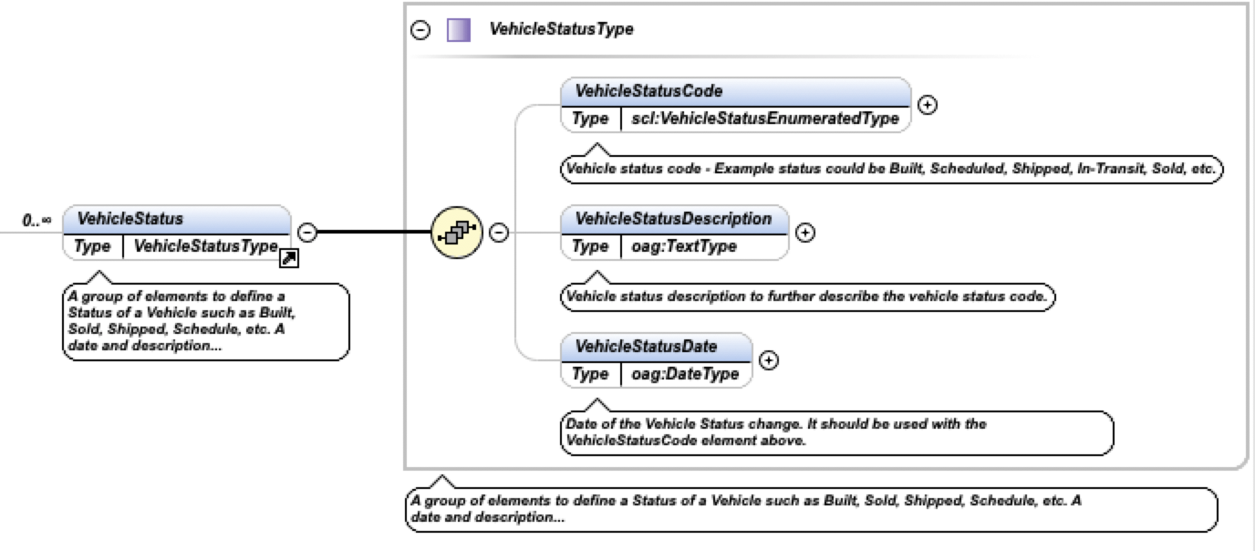
Vehicle Refactoring Actions
New “Vehicle Status” Component
Current STAR 5 elements can hold only one value
Merge with VehicleActivityStatus and VehicleActivityStatusDate redundant elements
Values are “Sold” “Built” “InTransint”, etc.
New generic common component can hold multiple values
Easier to maintain and extend if necessary
Standards for Technology in Automotive Retail

Slide 10
Common Refactoring Actions
Redesigned “Pricing” Component
Look at different pricing scenarios such as Tax, Discount, Charges, Price, etc. to determine if we can build a Component to handle all the pricing/amounts scenarios (this goes for Parts, Service and Vehicles).
We have looked at the OAGIS 10.5 “Pricing Component”, and decided that it would be a good starting point, and with the addition of the “GeographicalCoordinate” component.
--- STAR New Pricing
--oag:Pricing
--oag:GeographicalCoordinate
--
--
Standards for Technology in Automotive Retail

Slide 11
Metadata Concept
Standards for Technology in Automotive Retail
Standards for Technology in Automotive Retail

Slide 12
Metadata Concept
A metadata model to describe and produce other data
Using Java Tools
Create Java Classes from XML Schemas (JAXB)
First step to produce the metadata in Java code
New modifications to XML schemas are now coded in Java going forward
STAR tools produce XML and JSON schemas from Java Classes
Create XML Schemas from Java Classes (schemagen)
Create JSON Schemas from Java Classes (Jackson)
Create other data formats from Java Classes such as YAML (Jackson)
There are some issues in the generated Java code from XML schemas related to missing schema documentation. However, there is a workaround.
Some manual work would be needed to add the annotations in jaxb format.
Standards for Technology in Automotive Retail

Slide 13
Metadata Concept
A metadata model to describe and produce other data
Using SPARX Enterprise Architect
Import XML Schemas into EA
Produce XML Schemas from EA
Produce JSON from EA
Step 1 works with some limitations that need further research
Have not tried steps 2 and 3 yet
Standards for Technology in Automotive Retail

Slide 14
NEXT STEPS
Standards for Technology in Automotive Retail
Standards for Technology in Automotive Retail

Slide 15
Next Steps
Continue the refactoring of the Vehicle and Parts domain BODs.
Refactoring order is based on the BOD usage survey results.
Parts Master Vehicle Inventory
Parts Inventory Vehicle Specifications
Parts Order Vehicle Invoice
Parts Shipment Vehicle Service History
Parts Invoice Vehicle Order
Parts Return Vehicle Telematics
Parts Activity Vehicle Order
Parts Price List Vehicle Data Availability
Parts Locator Vehicle Initiative Payment Invoice
Parts Disposition Vehicle Payment
Parts Delivery Detail
Parts Pick List
Standards for Technology in Automotive Retail

Slide 16
Next Steps
Complete the refactoring of the Vehicle Inventory BOD
currently at about 95%
Complete the Refactoring of the Parts Master BOD
currently at a about 75%
Goal by January 15 2020
Parts Master, Parts Inventory and Parts Order
Vehicle Inventory, Vehicle Specifications and Vehicle Service History
JSON Schemas derived from selected Common Components (TBD)
February 2020 STAR Meeting in Las Vegas - Deliverables
Parts Master, Parts Inventory and Parts Order
Vehicle Inventory, Vehicle Specifications and Vehicle Service History
JSON Schemas (TBD)
One additional BOD from each domain would be great, if we have time
Standards for Technology in Automotive Retail
Notes:
As we move forward with the refactoring of components and BOD, it should get easier to refactor additional schemas as we become more efficient.

Slide 17
Next Steps
Identify Use Cases and Business Benefits of the refactored BODs
Identify Use Cases and Business Benefits of JSON schemas
Possibility of aligning with cloud services such as
CDK Fortellis
Microsoft Dynamics 365 Automotive
Annata
Cox Automotive
RouteOne
Standards for Technology in Automotive Retail
Notes:
Very Important. Need support from Members and SC. Cloud services are using JSON as the preferred data format.

Slide 18
Refactoring Workflow
Standards for Technology in Automotive Retail
Standards for Technology in Automotive Retail

Slide 19
Refactoring Workflow
BOD analysis and proposed modifications in Excel format (Paco)
Support from GM and Volvo at the review level
A Weekly meeting would be beneficial
Group review of proposed changes in Excel format
Group may suggest changes to the Excel workbook
Approval of Excel workbook
Schema modifications (Paco)
Group review of XML schema and approval
Standards for Technology in Automotive Retail
Notes:
After working with two BODs, in my opinion, it would be a faster process if I analyze and document the potential modification in Excel format. I would need GM and Volvo Teams to help with answering questions I may have, and reviewing the Excel document. Having a meeting once a week will be beneficial.

Slide 20
JSON Schema
Possible Solutions
Implement a Metadata Model in Java
JAXB: to migrate XML schemas to Java Classes
Schemagen: to generate XML Schemas from Java Classes
Jackson: to generate JSON Schemas from Java Classes
Implement a Metadata Model in SPARX Enterprise Architect
Import XML schemas into EA data structures
Generate XML Schemas
Generate JSON Schemas
Needs more research and testing
Standards for Technology in Automotive Retail
Notes:
Proposed short term solution is to use Java. We should be able to generate JSON schemas before the 2020 STAR Meeting in Las Vegas.

Slide 21
Questions and Comments
Standards for Technology in Automotive Retail
Notes:
Proposed short term solution is to use Java. We should be able to generate JSON schemas before the 2020 STAR Meeting in Las Vegas.

